Slide 1
Becoming a Data-Driven Risk Manager:
Enhancing Your Department’s Value Across the Enterprise – Featuring US Foods
Notes:
Welcome – thank you so much to RIMS for the invitation to speak with all of you today.
Origami Risk’s partnership with RIMS is one that we greatly value and appreciate, as we continue to serve the needs of the members and receive great feedback used in the future of our solutions.
I see many familiar faces from over the years, doesn’t it feel even better to see each other again this year in person?!
This year, we’ll be discussing how to enhance your department’s value across the enterprise through the reliance on data – and I’m not going to do this alone…

Slide 2
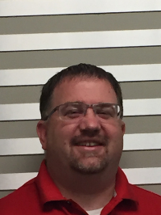
Today’s Speakers
Gina Rothweiler
Paul Brandel
Senior Sales Executive, Origami Risk
Risk Manager, US Foods
Notes:
For those of you who don’t know, I am Gina Rothweiler - Senior Sales Executive at Origami Risk. (Gina is a skilled, senior leader in risk management and technology with 30 years of experience in risk management, consulting, client service, management, and sales. As a Senior Sales Executive at Origami Risk, Gina is responsible for delivering new business solutions to prospective clients. Gina holds a Pre-Law degree from Penn State University and has her ARM designation.)
I’m so honored to be joined by a friend, client, and well-respected leader in the field, Paul Brandel.
Paul Brandel is the Risk Manager for US Foods®. US Foods is one of America’s great food companies and a leading foodservice distributor, partnering with approximately 300,000 restaurants and foodservice operators to help their businesses succeed. With nearly 28,000 employees and more than 70 distribution centers, we provide our customers with a broad and innovative food offering and a comprehensive suite of e-commerce, technology and business solutions. The company also operates over 70 wholesale warehouse stores and 14 processing facilities. These include 12 Stock Yards® facilities that provide high-quality center of plate, custom cut and packaged to customer specifications; Freshway Foods, a fruit and vegetable processor, re-packer and distributor; and Save On Seafood, a seafood processor and distributor.
Paul began his career in 1999 as multi-line claims adjuster for Marriott International. Following Marriott International, he held multiple positions with Gallagher Bassett servicing both captive and self-injured clients. In 2007, Paul accepted the Claims Manager position with Hyatt Hotels Corporation and then accepting a Risk Manager position with Rockford Mass Transit District in 2010 and Waterton in 2014. Prior to his current position with US Foods, Paul served as the Risk Manager for Eby-Brown from 2016-2019.
Mr. Brandel serves as a Workers’ Compensation Practice Group Advisor for the USLAW Network. He is a past President of RIMS Chicago Chapter (2018) and past chair of the Risk & Safety Committee for the International Foodservice Distributors Association (2016-2019).

Slide 3
Notes:
SO, as we get started, I wanted to share a poll from a recent webinar Origami hosted on AI, data, and the factors holding organizations back from going farther.
We had over 200 people attend this event and this poll shows us some interesting insights.
We asked the audience: What factors make it difficult for you to gain insights from data?
We heard: available tools and techniques + quality of data leading the way…

Slide 4
Technology – Hard Truths
4
Technology is not a “silver bullet.”
Technology may no longer even be a differentiator.
Getting the most value out of technology.
4
Notes:
And the audience was so right.
As much as we might wish it were so, implementing and providing access to technology is not a “silver bullet.” Put another way: One size does not fit all. And throwing technology at a problem is very rarely, if ever, the answer. In fact, technology may no longer even be a differentiator.
By that, I mean having a technology solution in place at an organization and using it to deliver services to stakeholders or clients is at this point akin to “table stakes.”
It’s what’s expected. When it comes to technology, what matters is not that you have it. It’s how effective you are at ensuring you and your stakeholders get the most value out of it that you can.

Slide 5
Technology: Increased Expectations
24-7 access to information and the ability to self-service
Insuretech “hype” – Promises of quicker, faster, easier
These shifts in expectations are contributing to ever-growing pressure on risk managers to differentiate themselves by delivering better and more complete pictures of data.
5
Notes:
Unfortunately, the truth is that technology… or the expectation of technology is partly to blame. 24-7 access to information and the ability to self-service is, at this point, baked into brains and informs our expectations.
We want what we want, and thanks to the immediate delivery made possible by technology… we want it now. Not to mention enhancement promises on the horizon, when what will matter is not what “new digital technologies” can actually do to match or serve as a substitute for the value you provide.

Slide 6
So, What Part Can Technology Play?
Realize efficiencies
Deliver tailored reports and actionable insights
Communication/ Information
Technology can contribute to solving the challenges you face.
Help gather and organize data
Exposure values for property and assets
Historical loss data
Loss prevention and safety program data
Consolidation & Organization of Data
6
Notes:
BUT – when planned expectations meet risk analysis and preparedness,
Technology can also contribute, at least in part, to solving the challenges you face. The right technology, properly applied, can be a major contributor when it comes to transformation and the value your department provides its stakeholders.
Ultimately, the strategic decisions you and your team make aligned with the support of technology can greatly contribute to organizational resilience and risk assessment, analysis, and mitigation.
Today we will explore how US Foods is discovering this on their Risk Management Journey…

Slide 7
INDUSTRY CASE STUDY
US FOODS

Slide 8
US FOODS: Operations
Broadline: ~70 Distribution Centers
Chef’Stores: ~80 Stores
Culinary Equipment & Supply: Stores/Distribution Centers
Specialty
Freshway – Produce
Amerifresh – Produce
Save on Seafood – Seafood
Stock Yards – Meat
Freight Broker: Gampac

Slide 9
US FOODS: Starting Point
Goal: Value through a system to streamline efficiency, while ensuring accuracy
Began with vendor payments and took only weeks to get started
Continued journey to include:
Product Incident Portal (QR Code accessible);
Food Safety Quality Assurance (FSQA);
Bond Tracking; and much more.
Notes:
cost conscious organization: Software requirements: cost effective, replace manual internal systems, highly configurable, and provide insightful data for decision-making across the organization
Partnered with Origami Risk from spreadsheets
Manual and multiple systems, couldn’t do reporting rely on other departments to provide reports and if they wanted a specific insight - they were limited to the other department’s capabilities
TCOR, budget purposes - what has been our spend for rm as a whole and slices (i.e. premiums, OR, brokers, cyber) - see what you paid in the year and PY costs
How are we looking - here is where we are at?
Transaction level
Analytics gained: premiums are up, but x is down - future looking
Once input - invoice and payment coding is sent to submitter, gets forwarded to AP
Bond tracking - pain point: turnover in partner companies - when a person submits, person requesting is embedded - you can verify over the years and track who requested… paying the right bonds and renewing the right ones (i.e. turnpikes, electricity) - $100 - thousands

Slide 10
US FOODS: Intelligent Vendor Payment Tracking
Track all vendor payments related to insurance (i.e. claims loss)
Visualization between spend per fiscal period and payment upfront
Process: employees input payment and an email from AP is automatically generated
Automated Amortization Report for monthly accruals
Dashboard & Reporting: invoice amounts by vendor, vendor coverage, by vendor (i.e. broker)

Slide 11
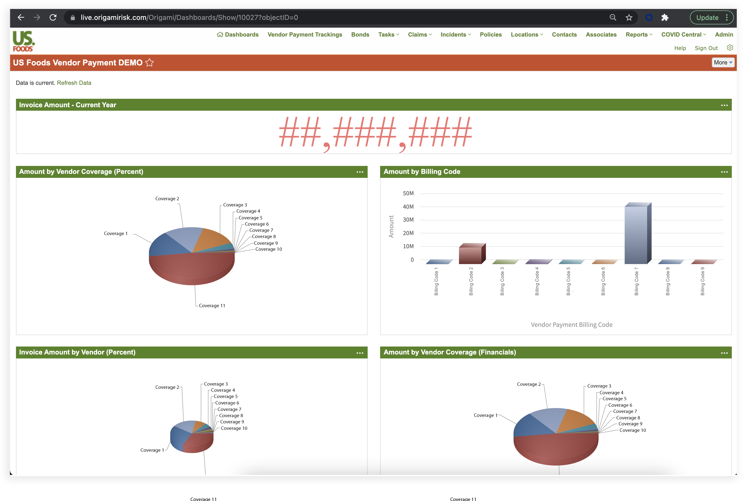
US FOODS: Intelligent Vendor Payment Tracking

Slide 12
US FOODS: Continuous Improvement - Food Safety Quality Assurance (FSQA)
Submit and track product incidents through the anonymous incident portal link
Vendor product included (ASYS Number/SKU)
QR Code availability
FSQA Employee Impact:
Track vendor responsibilities
Easily see month by month how many product incidents are submitted, how long it takes to be addressed, and how many are still open
Merger of two systems and reduction of reliance on manual/paper processes
Notes:
Under QR code availability bullet: – i.e. post to a wall, anyone with a smartphone can access this
2 different systems and create a new report
Communication continued between the FSQA and the vendor until it is resolved
PSSA internal form, hand off to enter in system, re-keyed into the system, system will then notify, FSQA will review keyed system
Removed manual piece of this process - PSSA keys directly - FSQA review - send to PSSA if any questions (grant access links - all in origami)
Product Services & Sales Administrator
Root cause analysis - Origami Risk

Slide 13
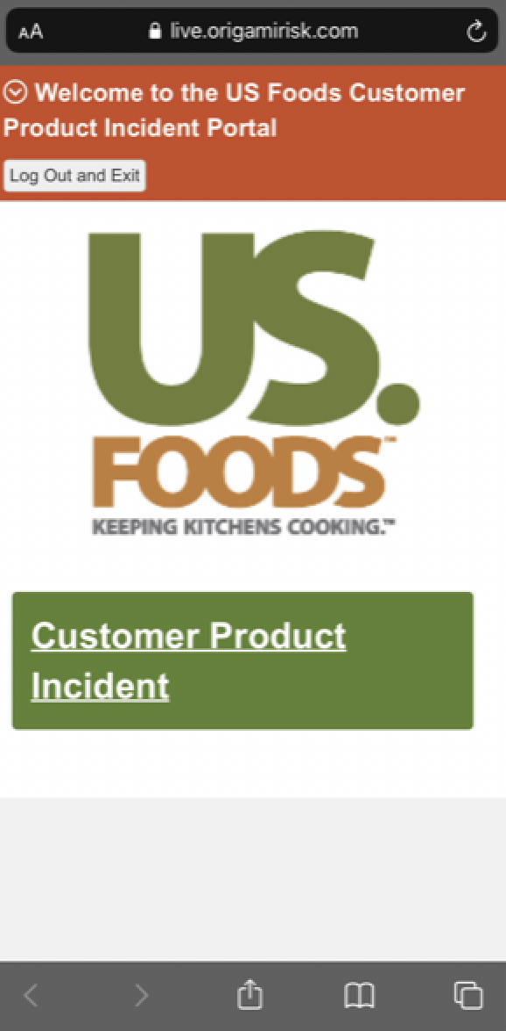
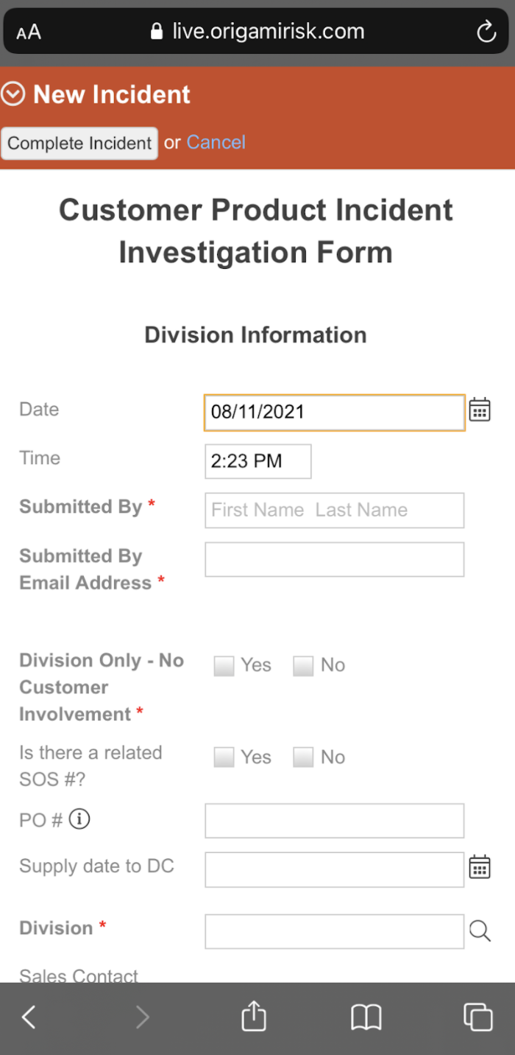
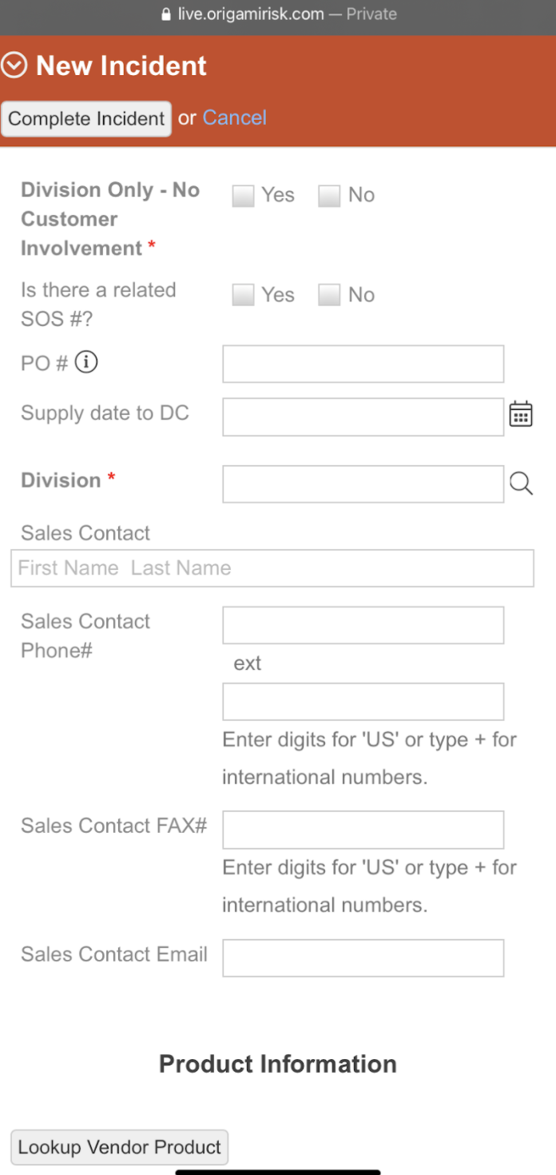
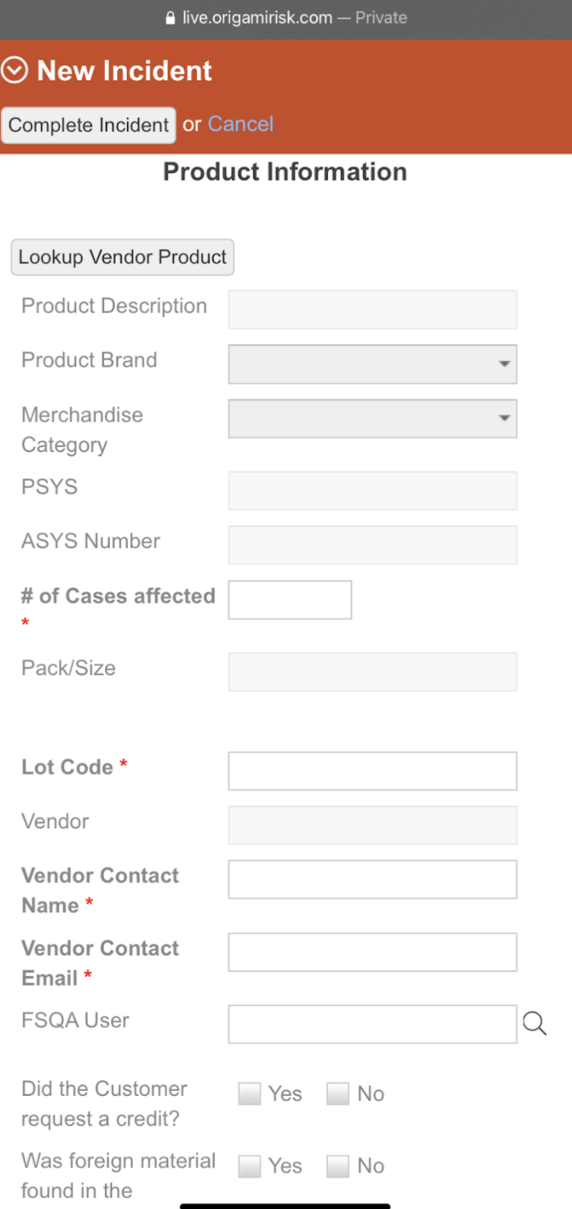
US FOODS: Product Incident Management Portal

Slide 14
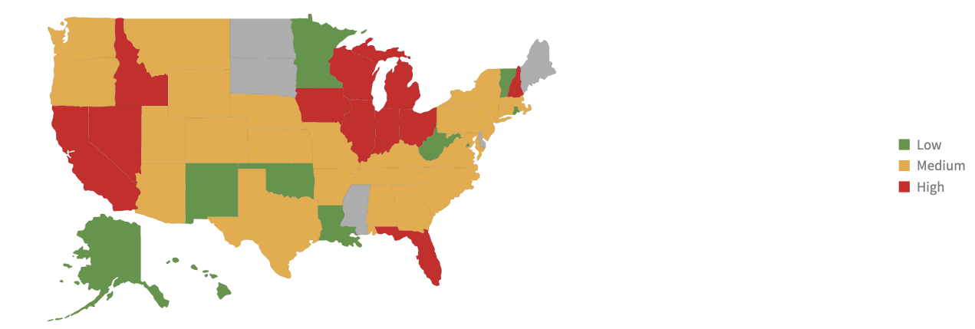
US FOODS: Product Incident Management Portal

Slide 15
US FOODS: Product Incident Management Portal

Slide 16
US FOODS: Looking Ahead
IT Team feed for FTP site containing files for all product, customers, and vendors:
Keep up-to-date with products and vendors constantly changing
Track bonds and vendors
Manage acquisition requirements – Example:
Washington Workers Compensation: US Foods TPA does not currently have the ability to generate the WA incident forms.
WA managers can utilize Origami Risk to submit.
The WA form will be generated, attached to the incident report, and the incident will be made into a claim.
Notes:
Voluntary COVID-19 Vaccine Tracking & Delta Variant
Highly regulated industry meets customers with varying requirements (impacting deliveries and more)
Supporting 25,000 employees across multiple states
Origami Risk provides regional data for intelligent decision making, including:
Vaccines by Region, Percentage % by Region
Shared data across the enterprise: Human Resources, M&A acquisitions
M&A: Acquisition of Smart Foodservice® - US Foods CHEF’STORE®
company incentives for voluntarily submitting vaccine records

Slide 17
DATA-DRIVEN RISK MANAGER
Insights & Technology

Slide 18
Technology that Delivers Value
Communicating, tracking, and monitoring risk data and related documents
More advanced options, i.e., collection of exposure values
Meeting the needs of executives who value data solutions

Slide 19
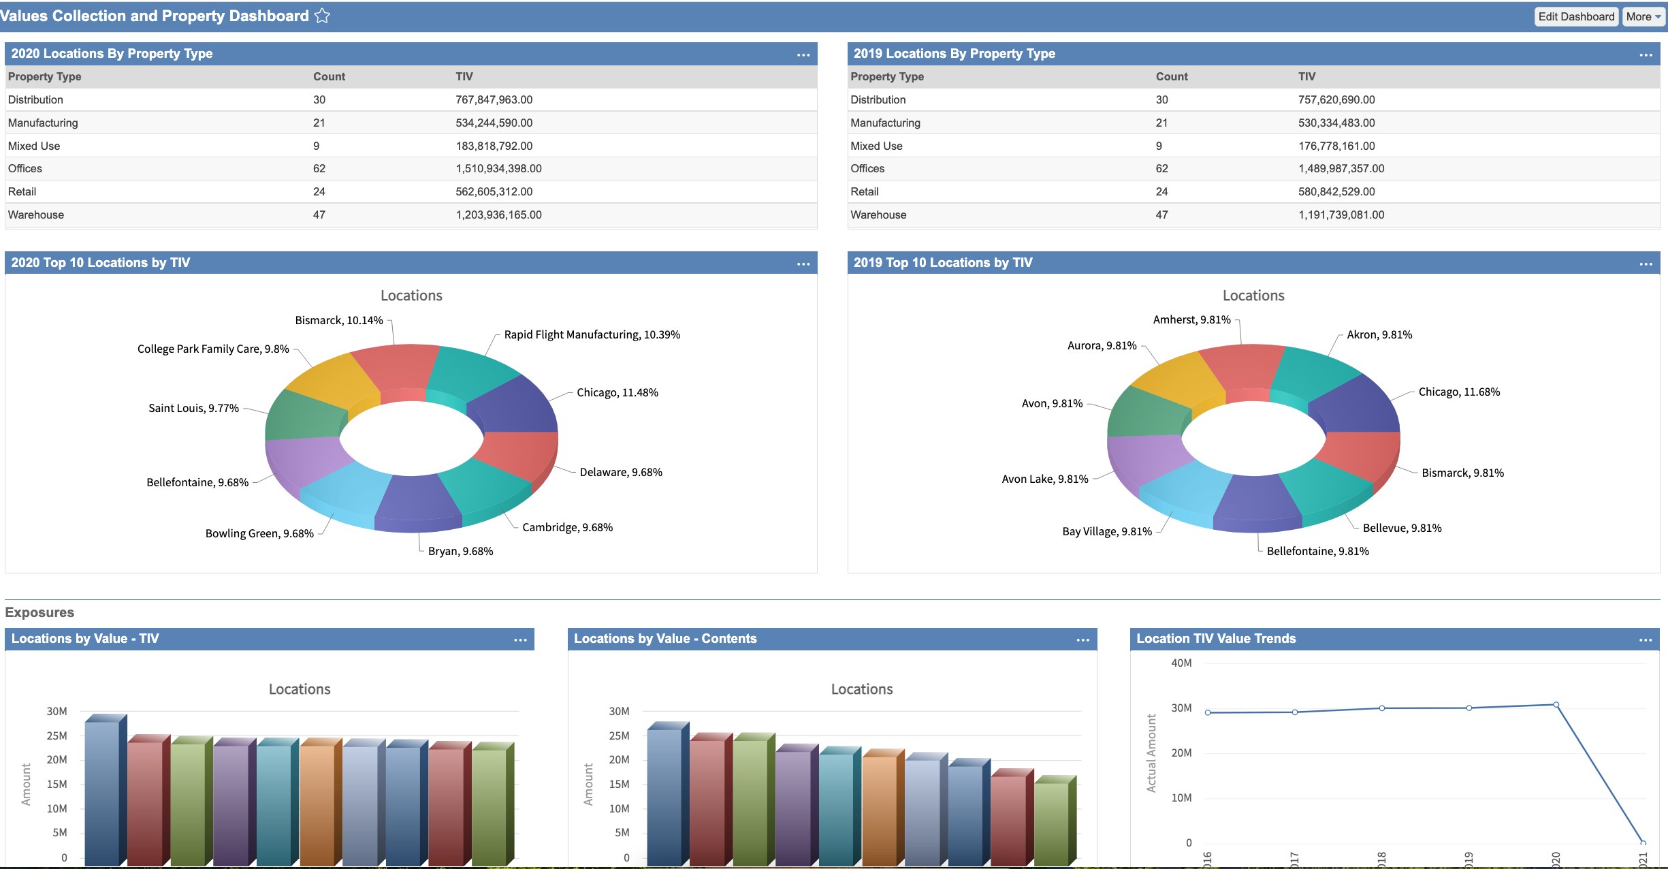

Slide 20
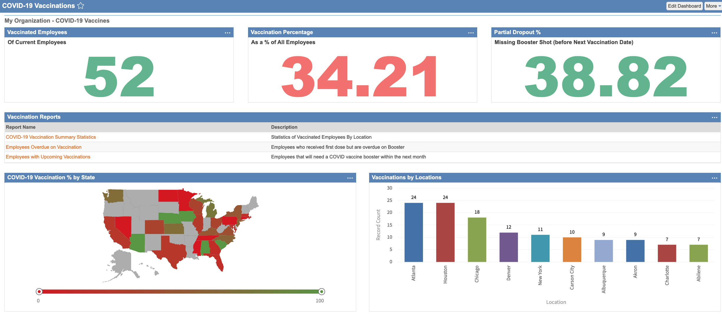

Slide 21
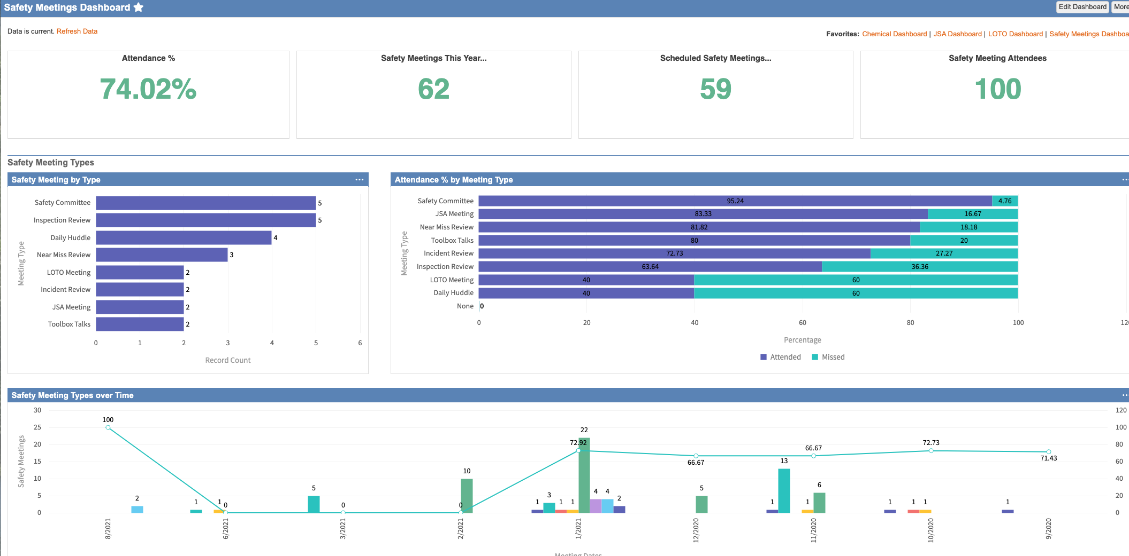

Slide 23
The Path to Data Driven
Centralize
Push data where it needs to go
Align with objectives
Expand the data set
Move to continual process
Report insights, not data
Notes:
Centralize (knock down data silos, honor that one source of truth)
Push data where it needs to go (upstream and downstream)
Align with objectives (speak their language, understand the goals - tell the story of how the program or data set can take them there)
Expand the data set (take a wider view, look at the enterprise - are you connecting dots?)
Move to continual process (life isn’t quarterly, proactively address issues or opportunities)
Report insights, not data (make it actionable)

Slide 24
Where should you invest?
If you’re going to commit to this technology, you have to know who is going to use it...
When does it makes sense to invest in new technology?
Notes:
Where should you start in order to make sure you’re making the best use of the technology you already have?
And how can you tell when it makes sense to invest in new technology? The answer, once again, is “It depends.”
There’s no getting around the fact that the pressure to offer insuretech solutions is, in many ways, brought about by the “buzz” that accumulates around a new technology.
At Origami, we are constantly asked by clients about new trending technology. Either they’ve read an article, have spoken with a new Insuretech that is driving innovation or been asked about it. But many times when I respond asking how it would help their business or their own customers, there is hesitation. Have goal in mind, develop KPIs with your vendors and across the organization …

Slide 25
WHO IS ORIGAMI RISK?
SaaS Technology
Platform
Cloud-based
Risk Technology
Platform
Headlining 2021: Leader in “2021 RMIS Report” by Redhand Advisors – NPS 9x that of competitors
23
Notes:
Origami Risk is based right here in Chicago, we are a Software as a Service Vendor…100% web-based Origami Risk was founded in 2009 by a small team of industry veterans who saw the need for a single-version, cloud-based risk management information system (RMIS) platform. Today, we’re a leading provider of RMIS technology serving some of the world’s largest corporations, insurance brokerages and government entities.
That not just me saying that: Year after year, the results of RMIS user surveys, published in independent assessments such as Redhand Advisors’ RMIS Report show we lead other vendors when it comes to our technology and service.
Over the past decade, we’ve grown to become a company of more than 400+ employees delivering software and support to over 720+ companies around the globe. Why such rapid growth? Well, as all of us know, the insurance world is tightly connected and word gets around. That and a lot of hard work that revolves around a singular focus on helping our clients achieve their specific business objectives.

Slide 26
Fix Siloed Data
Notes:
More recently, an additional part of our growth is expansion into Governance, Risk and Compliance. Origami’s GRC technology includes integrated solutions designed to help Fortune 1000 & mid-sized organizations better manage Enterprise Risk and Operational Risk, Business Continuity, Internal Audit and Compliance Management programs and processes. We’re also rolling out comprehensive Environmental, Health and Safety functionality that is available as an out-of-the-box, turnkey package, or an enterprise solution that can be used along with Origami’s integrated RMIS functionality to help break down the silos between risk management and safety that have typically existed within many organizations.

Slide 27
QUESTIONS
Helpful Resources:
Vendor Performance Assessment Checklist
2021 RMIS Report by Redhand Advisors
| Gina Rothweiler GRothweiler@origamirisk.com
Notes:
Thank you so much for your attention.
I’ve listed some helpful resources on screen, including:
the 2021 RMIS Report by Redhand Advisors
And, the Vendor Performance Assessment Checklist – This assessment checklist has 35 core consideration points across four major topic areas and takes only a few minutes to complete. This assessment is intended for use in assessing new vendors or reassessing the relationship with your organizations’ existing software vendor(s).
Links to these resources can be found in the slides and on our website (OrigamiRisk.com)
We welcome all questions now!

