Slide 1
Scenario based cyber risk quantification: How to Enhance Insurance Strategy and Stakeholder Engagement using scenario based Cyber Risk Quantification
Dominic Keller, Willis Towers Watson
Andrew Adams, Kraft Heinz

Slide 2
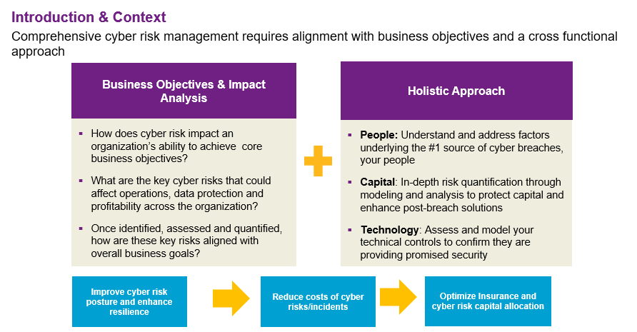
© 2020 Willis Towers Watson. All rights reserved. Proprietary and Confidential.

Slide 3
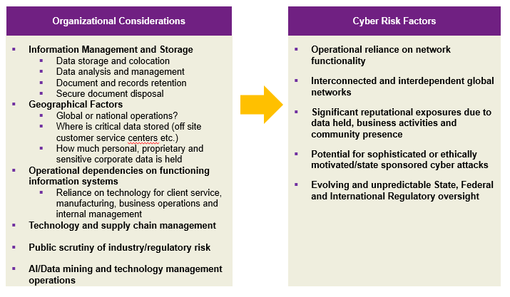
Introduction and Context
© 2020 Willis Towers Watson. All rights reserved. Proprietary and Confidential.

Slide 4
Scenario development
Key considerations for quantifying an organization’s cyber risks:
What are the key cyber related scenarios that could impact core business goals and operations?
How could these scenarios impact core clients, supply chains and corporate activities?
How would these scenarios materially impact the organization’s insurance program and what is the optimal insurance strategy to effectively transfer these financial risks?
Who are key stakeholders from the organization to provide financial and scenario quantification insights?
Sample Scenario topics/areas of focus:
Ransomware/system failure event:
  Operational outage (affecting production facilities)
  Organization wide/corporate system outage
Supply Chain Disruption
  Internal supply chain
  External/Third party supplier
Data Privacy Incident (related to PII or confidential corporate information)
© 2020 Willis Towers Watson. All rights reserved. Proprietary and Confidential.

Slide 5
Scenario development
  A key organizational challenge lies in understanding how many records are held, what the sensitivity of those records are and quantifying the financial exposures.
  A significant amount of data may be collected and stored in different ways:
    Personal Information
    Corporate information
    Anonymized data and aggregate data ‘pools’ for mining/analysis
    Quantifying the overall risk and financial risk of data held is based on numerous factors:
      Value of Personal data (not all PII is the same)
      Regulatory requirements on corporate data
      Type of anonymized data collected, stored and aggregated
      Data lifecycle (data collection, storage, management and destruction)
      Understanding the financial consequences of the data held requires analysis of all the above factors, tailored to business needs and current practices
© 2020 Willis Towers Watson. All rights reserved. Proprietary and Confidential.

Slide 6
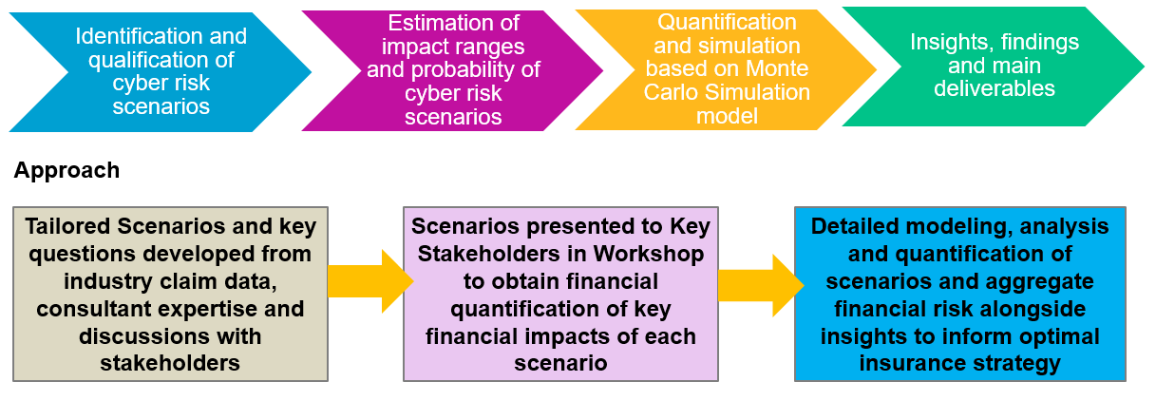
Sample Methodology
Process
Different cyber risk scenarios are modeled. Scenarios are tailored to organizational needs but may relate to data breach, ransomware and/or system failure threats. This consulting exercise quantifies the client's cyber risk exposure based on these scenarios and involves the following recommended phases.

Slide 7
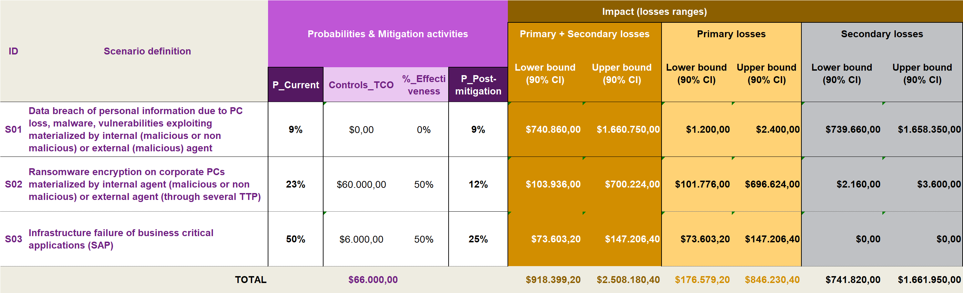
Sample Outputs

Slide 8
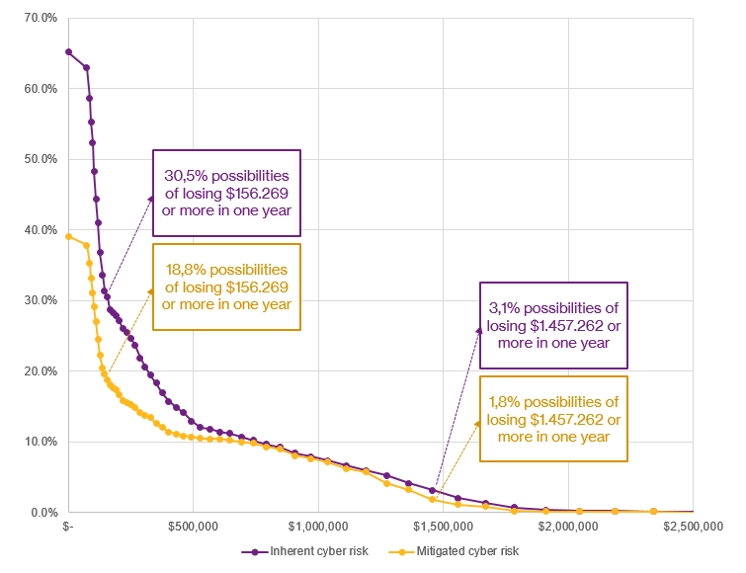
Sample Outputs
The organization can expect average annual cyber losses of $236.502 due to inherent cyber risk from Scenario 3.
Mitigation strategy reduces 28.21% of the inherent cyber risk loss potential.
© 2020 Willis Towers Watson. All rights reserved. Proprietary and Confidential.

Slide 9
Contact
    Dominic Keller
    Global Team Leader
    FINEX Cyber Risk Solutions Team, Willis Towers Watson
    Dominic.Keller@willistowerswatson.com
    Phone: (415) 806-2012
Andy Adams
Senior Manager—Corporate Risk Management
The Kraft Heinz Company
Office: (847) 646-1266 Cell: (404) 667-2069
andrew.adams@KraftHeinz.com
© 2020 Willis Towers Watson. All rights reserved. Proprietary and Confidential.

