Slide 1
Presented by James W. Stevenson, Jr. of Wiedner & McAuliffe
How to Best Evaluate Your Law Firm

Slide 2
Presenter
Jim Stevenson is president and managing partner of Wiedner & McAuliffe. He oversees the operations, technology needs, development, and expansion of the firm’s offices throughout the Midwest.
Jim frequently writes and speaks on workers’ compensation and employment law topics. He has served as a Board Member for the Workers’ Compensation Law Section Counsel and as Co-editor of the ISBA’s Workers’ Compensation Law Section quarterly newsletter. Jim is sworn in as an Attorney and Counselor of the United States. Jim is also an accomplished painter and recently completed a piece that took him over 3 years to finish (ask him about it!)

Slide 4
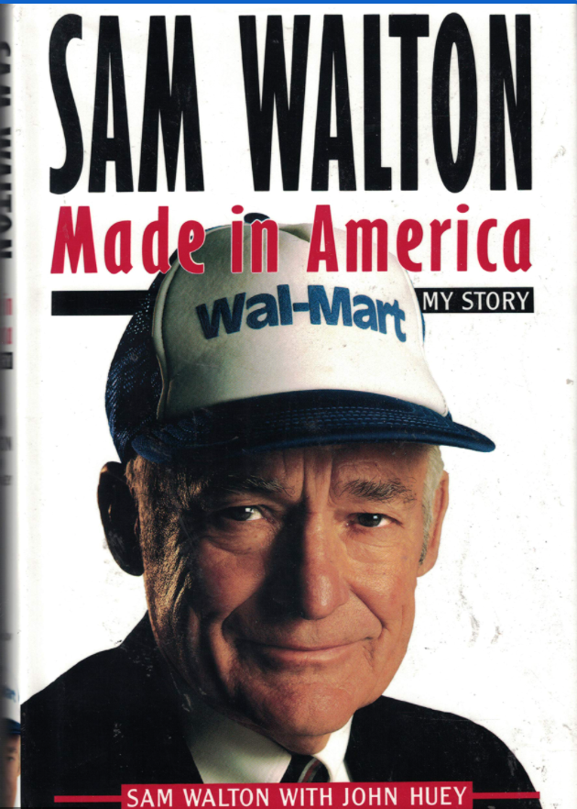

Slide 5
Legal Budgeting
Were you told what it would cost?
Did they stay within their budget?
If not, was there an explanation as to what changed and why?

Slide 6
Expense to Loss Ratio
How did the fees compare with the settlement reached?
What was the timeframe for resolution?

Slide 7
Exposure Analysis
Accuracy
Timeliness

Slide 8
Defined Plan of Action
Action Items for Case Resolution
Detailed timelines for same

Slide 9
Creative and Tailored Solutions
Did your law firm correctly identify your unique needs?
Did they tailor programs or solutions for you to get your claims to closure?

Slide 10
Questions? Contact Wiedner & McAuliffe
CHICAGO
1 No1900
Chicago, IL 60606
312.855.1105
KANSAS CITY
13200 Metcalf Avenue, Suite 110
Overland Park, KS 66213
816.761.3915
LAFAYETTE
11 North 3rd Street
Lafayette, IN 47901
765.362.7553
ROCKFORD
2990 NORTH PERRYVILLE ROAD, SUITE 4300
ROCKFORD, IL 61107
815.227.4300
ST. LOUIS
101 SOUTH HANLEY STREET, SUITE 1450
ST. LOUIS, MO 63105
314.721.3400

