Slide 1
September 16, 2021
D&O Claim Trends and Market Outlook

Slide 2
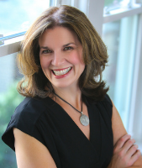
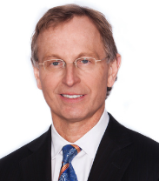
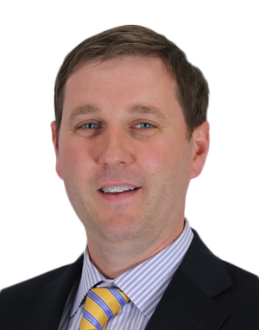
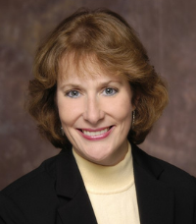
Panelists
Jacqueline Waters (Moderator): Jackie is a Managing Director and Practice Leader within Aon’s Financial Services Group (FSG) Legal & Claims Practice. She co-leads the team of attorneys and claim advocates who manage claims for Aon FSG clients.
Ross Wheeler: Ross is the co-leader of the Financial Services Group for the Central Region. He has oversight for the region’s placement of over $600 million in annual premium for financial lines.
David Kistenbroker: David is Global Co-Chair of White Collar Securities Litigation at Dechert LLP. He represents publicly traded companies and their directors and officers in securities class actions, SEC investigations, internal investigations, and corporate governance disputes.
Karen Golden: Karen is Director of Global Facilities and Risk Management at Navistar, Inc. She is responsible for all aspects of Navistar’s Risk Management function, including operational risk management, claims management, loss control, and traditional insurance procurement.

