Slide 1
All Things Business Interruption
Business Interruption 360º

Slide 2
Agenda
Business Interruption Overview
What are BI Values and why are they important?
How to measure a BI Loss?
What is the difference between Gross Profits vs. Gross Earnings?
How are BI Claims Settled?
What about Ordinary Payroll?
Contingent Business Interruption
How are Cyber BI losses different?
Why does Extra Expense policy wording matter? (Total discussion)
What Risk Managers should know about BI

Slide 3
Business Interruption Overview
Theoretically: To do for the insured what the insured would have done for themselves had no loss occurred.
Practically: The insured sustains an economic loss whose recovery is governed by the terms and conditions of the contract of insurance, sprinkled with a hefty dose of subjectivity.
Property Damage BI Chain Rule:
Physical damage (or alternate trigger)
To insured property (or contingent/service property)
By a covered peril in a covered territory
Causing a necessary disruption
Resulting in an actual loss
During the period of indemnity

Slide 4
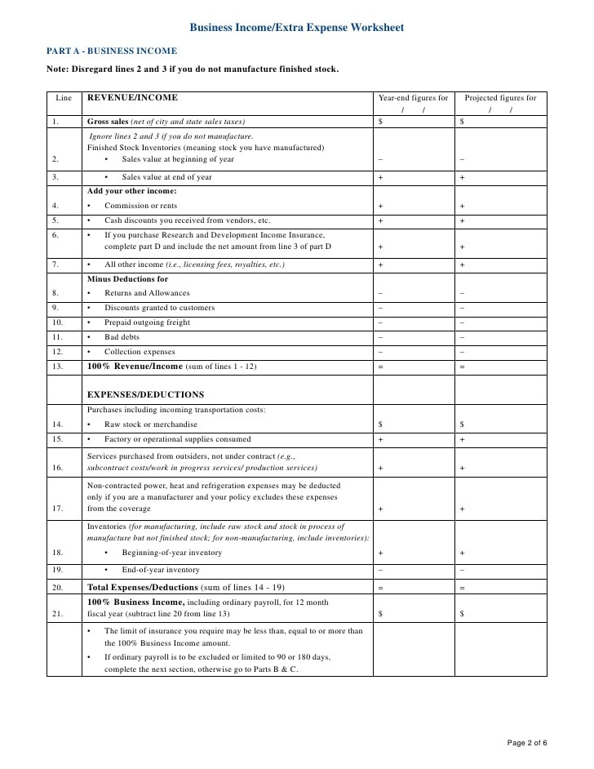
What are BI Values?
1. A projection of what the business will do during a12 month period
2. Calculated differently depending on form
Gross Earnings = Annual Net Sales - Direct Variable Expenses
Gross Profit (Business Income) = Annual Net Profit + Fixed Expenses
3. Policy requirement of most insurance markets

Slide 5
Why are BI Values Important?
PRE-LOSS
To determine annual premium
To allocate premium to business units
To determine Probable Maximum Loss (PML) and Maximum Foreseeable Loss (MFL) yardsticks
To determine Limits, Sublimits, maybe coinsurance
POST LOSS
To determine Average Daily Value (ADV) deductibles
To determine estimate BI loss, may be used to assist in setting loss reserves

Slide 6
How are BI Values calculated?
Corporate Level P&L
Allocation to Locations
Exposure Analysis

Slide 7
How to Measure a BI Loss?
BI Loss = Lost Revenues - Saved Expenses during the POI
What is the Period of Indemnity (POI)?
- Length of Time to Repair “As Was”
- With “Due Diligence and Dispatch”
- Possible Extended Period
What Inflows Were Impacted (Revenues)?
- Net Sales Lost due to Occurrence
- Projected Less Actual
- Predicting What Did Not Happen
What Expenses Were Saved?
- Projected Less Actual
- “Necessarily Continued”

Slide 8
Gross Earnings vs. Gross Profit: Which form is Right for You?
Gross Earnings:
Typically, more appropriate for manufacturing
BI Loss = Sales value of lost production less saved expenses during the POI
POI is the time to repair or replace damaged property with due diligence
Can be supplemented with extended period (EPOI)
Profits considered earned at the time of production
Gross Profits (aka Loss of Profits)
Typically, more appropriate for mercantile or retail operations
BI Loss = Lost sales less saved expenses during the POI
POI is specific to your policy, generally 12 months. But read your policy carefully because these forms have been changing considerably over the past few years.
Essentially follows GAAP accounting
Main difference is production vs. sales and the POI but the implications of choosing one over the other can dramatically affect the outcome of your claim.
Read The Policy (RTP)

Slide 9
How to Settle a BI Claim?
1. Understand the Process / People
2. Know Your Overall Objectives:
Maximize Insurance Recovery
Maintain Cash Flow
Accelerate Claims Process
Minimize Unnecessary Effort
3. How to Achieve Objectives?
Understand the Loss & the Process
Formulate a Plan of Action
Obtain Advance Payments
Simplify Adjustment Process
Prepare an Effective Claim
Manage Settlement Function

Slide 10
Claim Life Cycle

Slide 11
What about Ordinary Payroll?
1. Coverage to pay for people to stay home POST LOSS for Non-key employees i.e. “All payroll” except those of officers, managers, contract & other “important” employees
2. When is Coverage Needed?
Tight employment market
Highly skilled workforce
3. How Many Days Do I need?
Judgment call based on potential exposure

Slide 12
Contingent BI Exposure

Slide 13
CBI losses
The Contingent Business Interruption Chain Rule
The Contingent Business Interruption Chain Rule
Physical Damage or Loss
To Supplier, Customer, or Dependent Property
For a Defined Indemnity Period
Which Causes an Interruption
Of Type Covered
Insured Loss

Slide 14
Cyber Business Interruption
BI Loss = Lost Revenues - Saved Expenses during the POI
POI = Time to Repair / Restore to full operations
BI Trigger is caused by cyber event
Follows same process as property claim
Adjusted by law firms
Internal labor considerations
Read The Policy (RTP)

Slide 15
Extra Expense Exposures
Out of Pocket Expenses supported with documents, such as invoices
Calculated based on statistics with a base period and loss period
Consider inefficiencies, external costs, incremental costs, purchases, variable overheads, freight, fees, etc.
Does the cost have to reduce the BI loss?
Is EE defined as the Excess of “Total” Cost
Read The Policy (RTP)

Slide 16
Business Interruption Essentials for Risk Management
Key Takeaways for Risk Management
Have your team & resources ready before the loss
Make sure BI values are accurate & consistent
Understand your deductible before the loss
Know the basics & rely upon your experts
Master the property claims process
Read The Policy (RTP)
Q&A

Slide 17
Thank You!
RWH Myers & Company
SharonWolfe@rwhMyers.com
JeffEsper@rwhMyers.com

