Slide 1
Using Data to Measure Law Firm Performance
-Christopher Carucci, Client Executive Director, Gallagher Bassett -Jim Stevenson, Managing Partner, Wiedner & McAuliffe -Janice Van Allen, Senior Director of Risk Management, Walmart

Slide 2
Jim Stevenson
Jim Stevenson is president and managing partner at Wiedner & McAuliffe. He oversees the operations, technology needs, development, and expansion of the firm’s offices throughout the Midwest.
Jim frequently writes and speaks on workers’ compensation and employment law topics. He has served as a Board Member for the Workers’ Compensation Law Section Counsel and as Co-Editor of the ISBA’s Workers’ Compensation Law Section quarterly newsletter. Jim is sworn in as an Attorney and Counselor of the United States.

Slide 3
Janice Van Allen
Janice Van Allen is the Senior Director of Walmart’s Risk Management, responsible for the management of workers’ compensation claims for all divisions of Wal-Mart Stores, Inc., including Walmart Stores, Sam’s Club, and Walmart’s Logistics, and Transportation operations.
Janice develops and implements strategies to improve overall claim outcomes and efficiency for claims adjusters. She also leads Walmart’s ongoing efforts to determine whether insurance or qualified self-insurance represents the best risk financing method for funding work injuries in each state. As part of this process, she led Walmart’s initiative to provide an ERISA alternative for workplace injuries in Texas and qualified self-insurance in Maine. Janice implements teamwork-oriented strategy with claims administration and work injury defense to achieve a shared goal of success.

Slide 4
Chris Carucci
Christopher A. Carucci is a Client Executive Director for Gallagher Bassett, responsible for overseeing national accounts and litigation management. Prior to Gallagher Bassett, Chris held claim leadership roles at Everest National Insurance Company and Zurich North America. He also worked at AIG, managing nationwide, high exposure claims.
Chris is a professor at the CLM Litigation Management Institute and a frequent speaker at industry events on topics including claim management, litigation management, and good faith claim handling. He is a member of the American Bar Association, the New York Bar Association, the Claims and Litigation Management Alliance (Advisory Board Member), the Federation of Defense and Corporate Counsel, USLAW (Client Advisory Board), and the Defense Research Institute.

Slide 5
Topics to include…
Evolution of data in legal industry
Historical perspective of data management from legal to claims departments
Importance of managing data in risk management
Identifying and evaluating meaningful data and Key Performance Indicators (KPI)
How to access, maintain, and analyze Data
Effectively presenting data
Balance between data and existing relationships

Slide 6
Walmart and Hurricane Katrina Relief

Slide 7
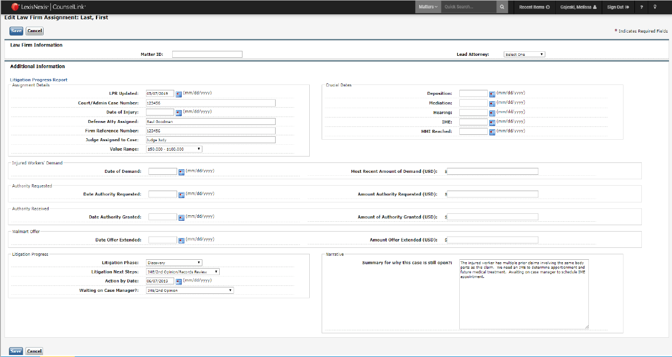
The Input– Litigation Progress Report

Slide 8
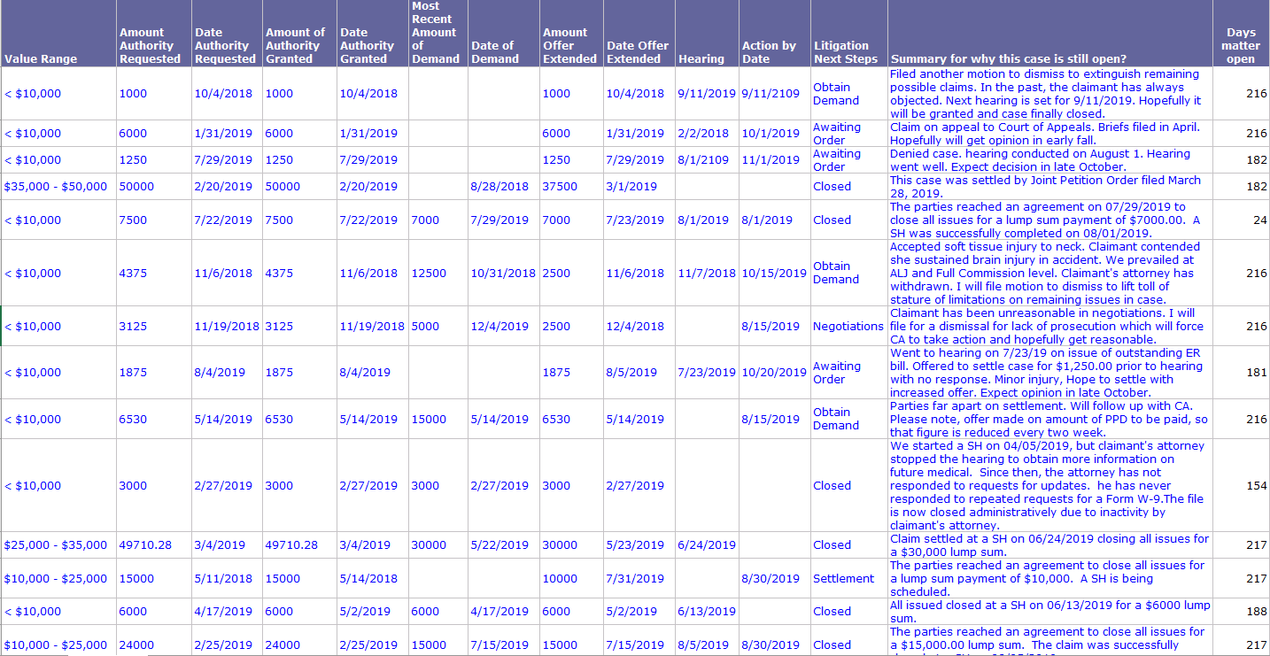
The Details– Litigation Progress Report

Slide 9
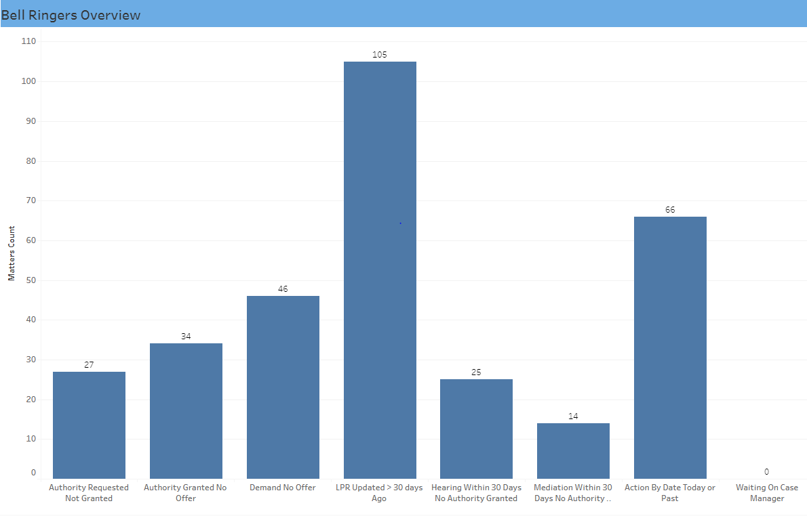
Identifying Outliers– Litigation Progress Report

Slide 10
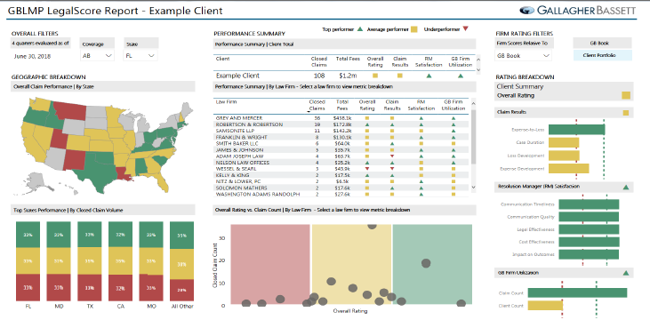

Slide 11
Questions?

