Slide 1
Parametric Nat Cat Insurance Covers
Swiss Re STORM and QUAKE

Slide 2
Parametric Nat Cat Insurance Background

Slide 3
Parametric Insurance Market – Background Information
Key Industries / Occupancies
Client Motivation
Hospitality: Hotel chains and single shot properties
Private Equity: Hedge funds, nat cat exposed acquisitions
Public Entity: States, counties, school districts, university systems
Energy / Power: Offshore assets, T&D exposure
Real Estate: Exposed office and retail schedules
Many others…
Supplement traditional insurance: In-fill deductible, top up limit, etc.
Broad cover: any loss or expense resulting from the event
Quick payout: Receive a payout in as little as 30 days post event
Cover under- or uninsured risk: Wide area damage, non-physical damage BI, excluded classes of businesses in traditional market
Swiss Re IRS Parametric Success
Bound ~60 parametric deals in 2018
Predominantly Hurricane and Earthquake (although we consider many other perils)
Annual premiums ranging from $3.4m (large) to $100k (small)
Wide variety of occupancy classes, but saw major success from private equity/hedge funds, hospitality, and public entity.

Slide 4
Needs for Parametric Nat Cat Insurance Covers
Buyer needs:
Protect against indirect economic loss
Supplement traditional insurance
Cover underinsured or uninsurable risk
In fill the large % deductible
Quick payout, improves liquidity
Simple and transparent claims process
Assist with post-event costs
indirect
loss
emergency
costs
quick
payout
simple
claims

Slide 5
What is a Parametric Nat Cat Insurance Cover?
Pre-defined event triggers and a table of payout factors are established.
A final policy is agreed to containing the details of the transaction and the requirements of the two parties (including trigger and payouts).
If an event occurs that meets or exceeds the pre-defined event trigger, then the product pays according to the payout table.
At a subsequent point in time (generally within 12 months of the event), the insured certifies that actual covered losses and expenses are greater than or equal to payout received.
Define Triggers
Event Occurs
Payment Made
Losses Confirmed
Bind Policy
*Note: This slide is a simple explanation of the product, the full policy will have all stipulations and details of the contract.

Slide 6
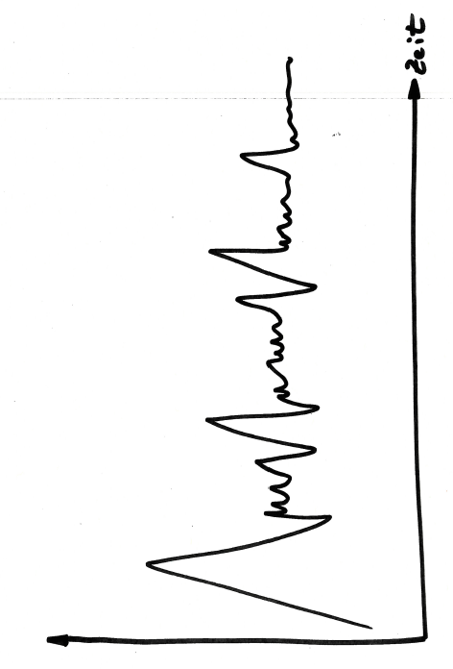
Why Parametric Nat Cat Insurance Cover?
Indemnity Based Insurance
Event Occurs
Insured assesses damage
Insured submits claim
Insurer reviews claim
Adjuster assesses and validates claim
Claim is paid based on assessment
Time
Parametric Insurance
Event Occurs
Intensity verified by third-party
Pay-out issued within 30-days
Confirm proof of loss within a year
Time

Slide 7
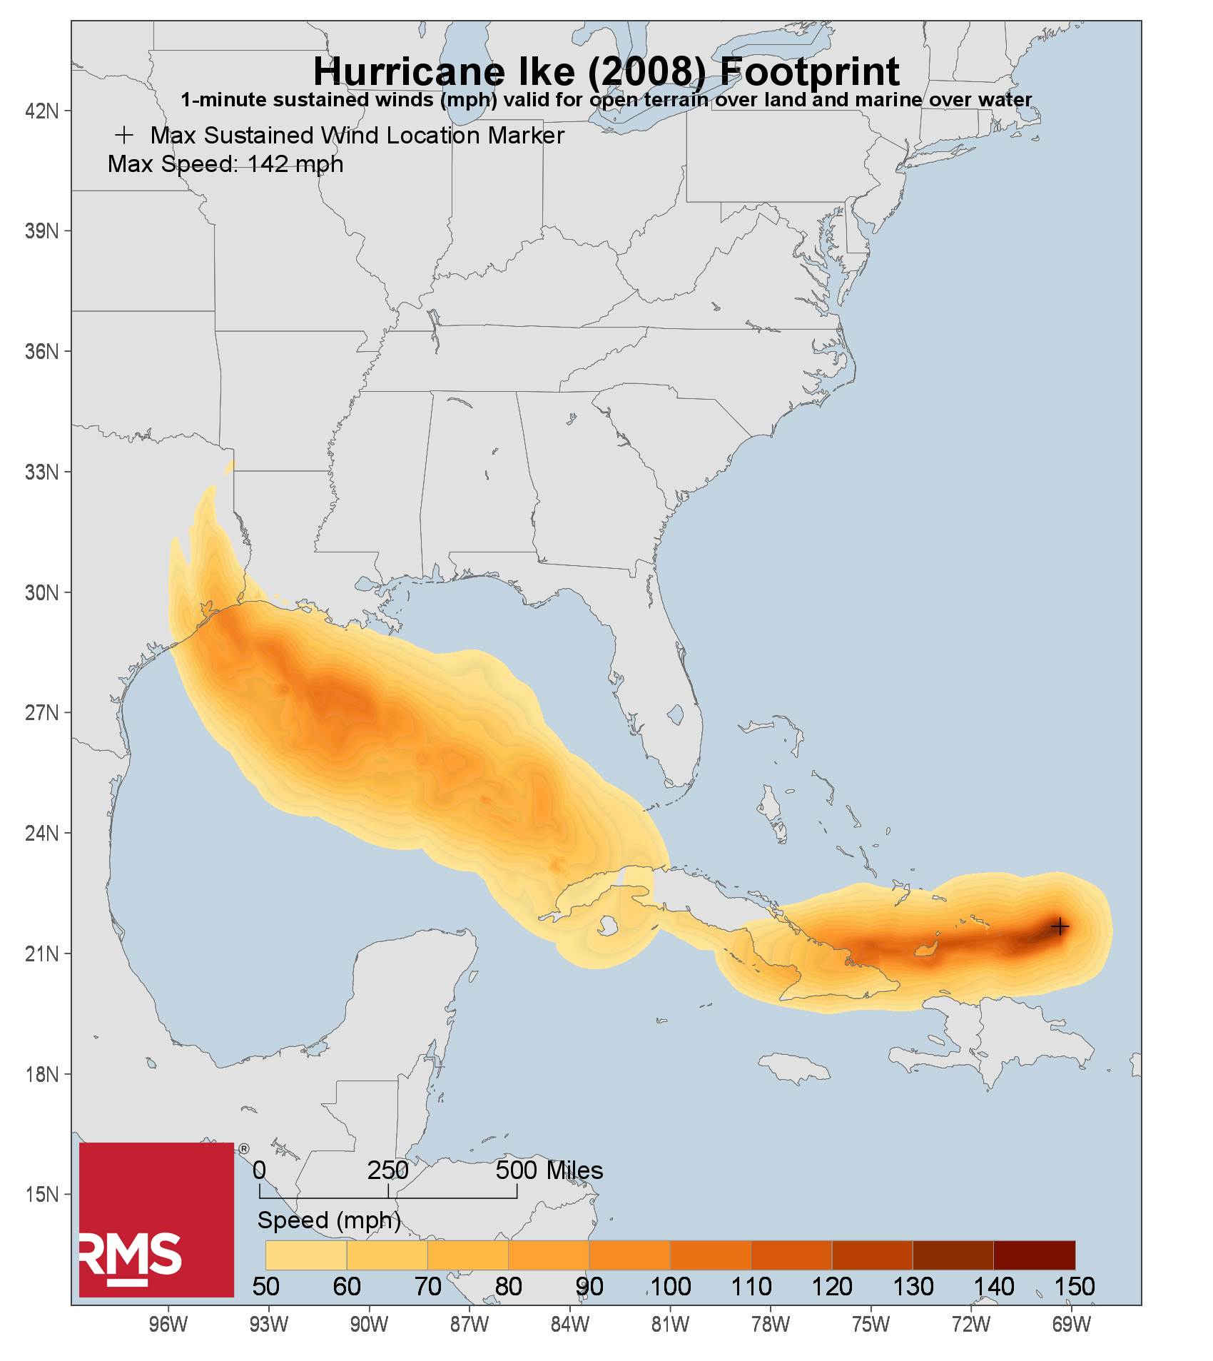
Key Features of a Parametric Insurance Cover
Uses Independent Data Provider: Wind speeds from named windstorm provided by independent 3rd party (RMS HWind) and the U.S. Geological Service (“USGS”).
Settlement: Based on RMS HWind reported wind speeds, or USGS shake intensities at your locations.
Offers Quick pay out: Pay out in as little as 30 days after notification of eligible event.
Coverage in Insurance Form: Insured has 12 months post event to determine and confirm actual financial loss.
Broad Coverage: All direct and indirect physical damage, loss of income, extra expense and any other expenses related to the Nat Cat event.
Addresses impact at a local level: The structure reflects the impact of and damage caused by wind speeds or shake intensities at each of your insured locations.
Deductible: None.

Slide 8
Swiss Re STORM

Slide 9
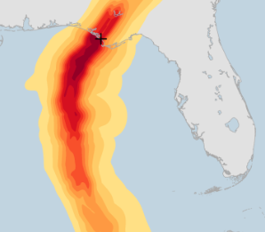
Swiss Re STORM Parametric Wind Intensity Specific to YOUR Exposure
Limit Allocation
Payout Table
Payout Table is established to determine the payout by wind speed at each Trigger Location.
Event Reporting
Post-event we receive a wind footprint from RMS HWind, which is used to determine the wind speed at each Trigger Location.
Payout
We pay you according to the HWind calculated wind speed and Payout Table.
Loss Confirmation
Limits are allocated to specific Trigger Locations (e.g. lat longs) to best reflect your exposure.
You confirm to us that your loss from the event met or exceeded the payout.
Hurricane Michael Footprint over Florida
Source: RMS HWind

Slide 10
What is RMS HWind?
The HWind Technology has been developed by world- leading extreme wind researchers. It uses the best available data from aircraft reconnaissance (“Hurricane Hunters”), dropsondes, buoys, weather stations and satellites.
WORLD CLASS SCIENCE
GOVERNMENT TECHNOLOGY
The sophisticated HWind Technology has been developed at the Hurricane Research Division of the National Oceanic & Atmospheric Administration (NOAA).
The HWind Technology is robust and provides highly reliable data for every location on the map. Weather stations can fail – HWind never does. It has proven to work in dozens of Hurricanes over the past decade.
PROVEN PRODUCT
*For more information, visit RMS HWind website: http://www.rms.com/models/hwind

Slide 11
Sample Solution – South Florida Insured
Cover: Named Windstorm Insurance Policy
Term: Three years
Effective Date: TBD
Swiss Re Share: 100%
Trigger: One-minute sustained wind speed at each trigger location as reported by RMS HWind
Trigger Locations: Lat long center of each zip code where exposure is reported
Limit Allocation: Proportionally by TIV reported at each zip code
Payout Tables: See subsequent slide
*Note: The above is a non-binding summary of our proposed structure.

Slide 12
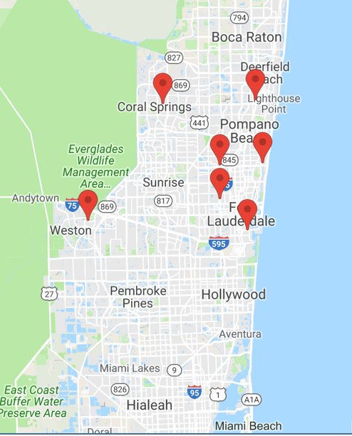
Limit Allocation – Visual
Trigger Location Map

Slide 13
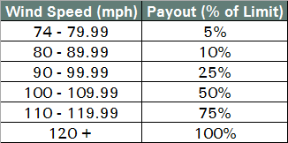
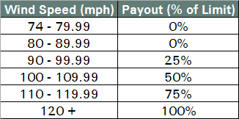
Sample Solution – South Florida Insured
 | Option 1 | Option 2
Limit | $25m per occ / $50m term aggregate | $25m per occ / $50m term aggregate
Payout Table
Estimated Premium* | $1,165,000 | $955,000
Rate-On-Line | 4.7% | 3.8%
*Premiums are annual and exclude all brokerage, taxes and fees.

Slide 14
Limit Allocation
Option 1
Option 2

Slide 15
Historical Payout – Hurricane Wilma – Option 1
Total Payout = $2,500,000

Slide 16
Swiss Re QUAKE

Slide 17
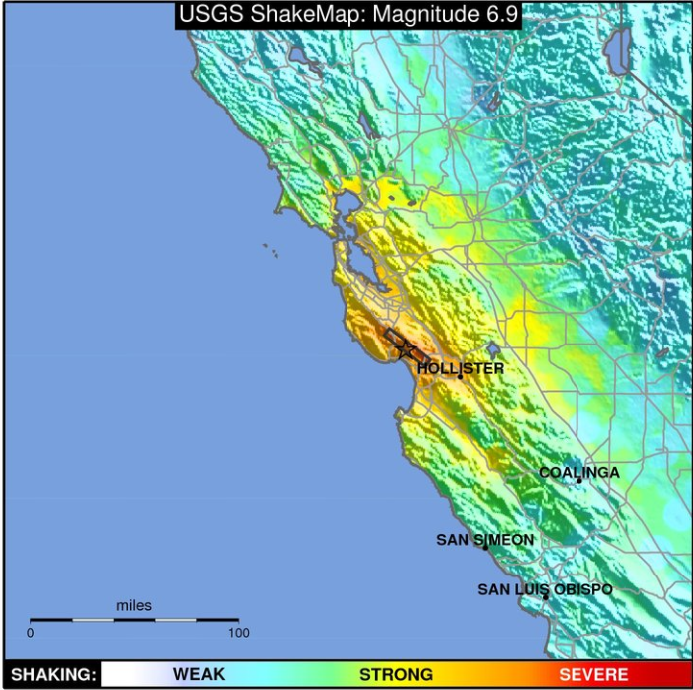
Swiss Re QUAKE Parametric Earthquake Shake Intensity Specific to YOUR Exposure
Limit Allocation
Payout Table
Payout Table is established to determine the payout by shake intensity (PSA 0.3s) at each Trigger Location.
Event Reporting
Post-event we pull the USGS ShakeMap, which is used to determine the shake intensity (PSA 0.3s) at each Trigger Location.
Payout
We pay you according to the USGS calculated shake intensity and Payout Table.
Loss Confirmation
Limits are allocated to specific Trigger Locations (e.g. lat longs) to best reflect your exposure.
You confirm to us that your loss from the event met or exceeded the payout.
USGS ShakeMap for Loma Prieta EQ (1989)

Slide 18
Earthquake: Intensity vs. Magnitude Trigger
Magnitude: The Magnitude is a quantitative measure of the size of the earthquake at its source. The Moment Magnitude Scale measures the amount of seismic energy released by an earthquake, as measured with a seismometer. Depending on the depth of the earthquake and the local soil types, same magnitude earthquakes can have a very different impact locally
Intensity: The effect of an earthquake on the Earth's surface is called the intensity. One intensity measure is the Spectral Acceleration (expressed in % of Earth’s acceleration g). This is the type of intensity measure Swiss Re’s QUAKE product uses.
A certain Magnitude of an earthquake unfolds into different Intensities in affected areas. Swiss Re QUAKE product uses Intensity triggers in order to more closely reflect your direct and indirect financial loss.

Slide 19
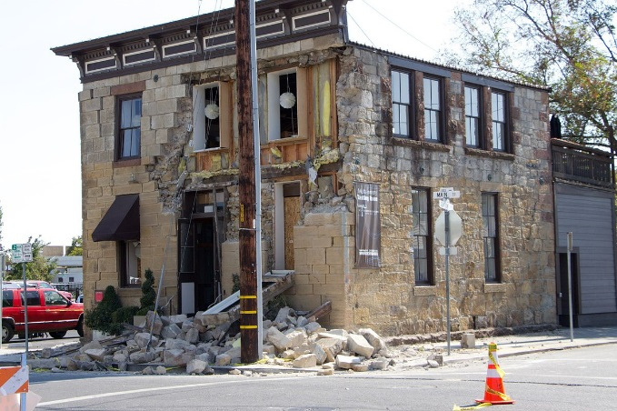
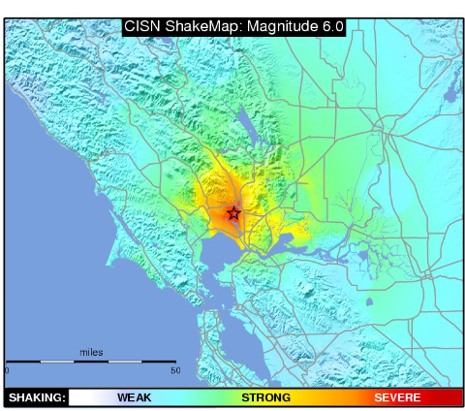
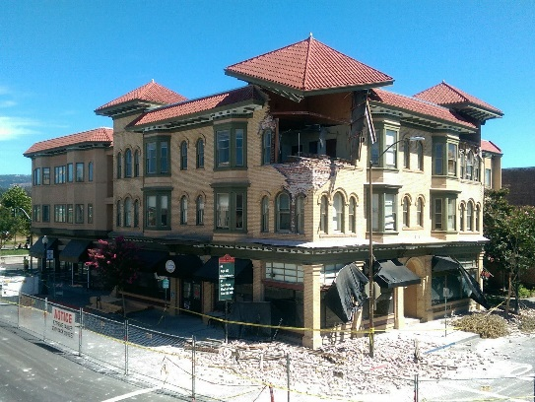
2014 Napa Earthquake
Magnitude 6.0
Epicenter
Downtown
Napa
PSA=80.67
*USGS Peak Spectral Acceleration expressed as a percentage of gravity (%g) with a period of 0.3s ("PSA03")

Slide 20
USGS San Andreas SCENARIO Event
Magnitude 7.7
Epicenter
70 Miles!
Silicon Valley
PSA=96
*USGS Peak Spectral Acceleration expressed as a percentage of gravity (%g) with a period of 0.3s ("PSA03")

Slide 21
Shaking Intensity – PSA03 Explained
Sample Experienced Shaking
PSA03 Range
Severe: Damage slight in specially designed structure; considerable damage in ordinary substantial buildings with partial collapse. Damage great in poorly build structures; Fall of chimneys, factory stacks, columns, monuments, walls. Heavy furniture overturned.
115%g
90%g
75%g
Very Strong: Damage negligible in buildings of good design and construction; slight to moderate in well-built ordinary structures; considerable damage in poorly built or badly designed structures; some chimneys broken.
60%g
45%g
Strong: Felt by all, many frightened. Some heavy furniture moved; a few instances of fallen plaster. Damage slight.
30%g
Physical descriptions of damage are from USGS and describe average impacts; actual observed conditions in individual structures could diverge from average impact.

Slide 22
Swiss Re Sample Structures –Southern CA Insured
Cover: Parametric Earthquake Policy
Term: Three Years
Effective Date: TBD
Limit: $10,000,000 per occurrence and in the aggregate for the term
Swiss Re Share: 100%
Trigger: Shake Intensity (PSA0.3) as reported by USGS at the Trigger Location
Trigger Location: Lat Long point associated with the client’s site
*This proposed structure is not bindable and would be subject to further review and approval.

Slide 23
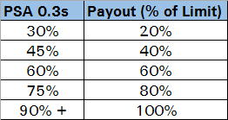
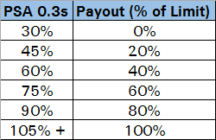
Swiss Re Sample Structures – Options
 | Option 1 | Option 2
Payout Table
Estimated Premium* | $420,000 | $200,000
Rate-On-Line | 4.2% | 2.0%
*All premium figures are annual, exclusive of brokerage, taxes and fees.

Slide 24
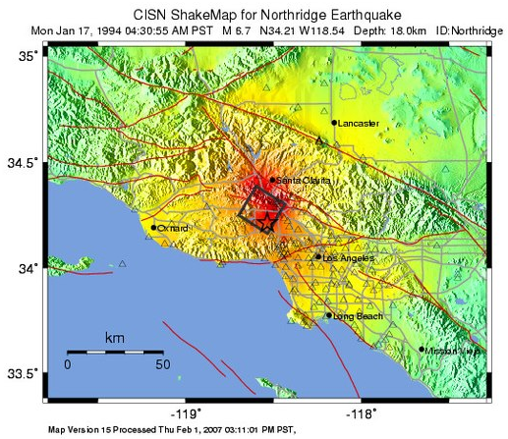
Example Payout – What Has Happened (Recently)? M 6.7 Northridge EQ – January 17, 1994
PSA0.3 @ Trigger Location:
31.5%
Epicenter
Trigger Location
Payout – Option 1
Payout – Option 2
More Info: https://earthquake.usgs.gov/earthquakes/eventpage/ci3144585/executive

Slide 25
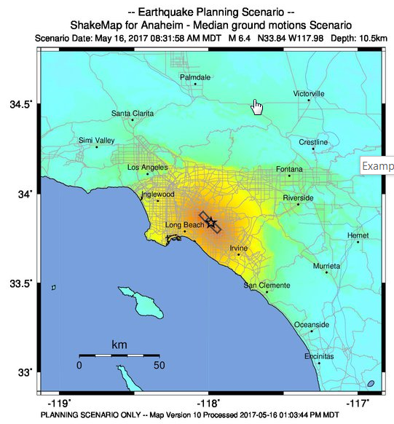
Example Payout – What Could Happen? M 6.4 SCENARIO Earthquake - Anaheim
PSA0.3 @ Trigger Location:
108.1%
Epicenter
Trigger Location
Payout – Option 1
Payout – Option 2
More Info: https://earthquake.usgs.gov/scenarios/eventpage/bssc2014anaheimellbgeol_m6p39_se#shakemap

Slide 26
Appendix

Slide 27
Traditional Indemnity vs. Parametric Insurance Cover
 | Traditional Insurance | Parametric Covers
Trigger | Loss or damage to physical asset | Event occurrence exceeding pre-agreed threshold or trigger
Recovery | Reimbursement of actual loss sustained following assessment | Pre-agreed payment structure based on event intensity
Basis Risk* | Policy conditions, deductibles and exclusions | Correlation of chosen triggers and structure with actual exposure
Loss Assessment and Payment | Months to several years depending on complexity of loss | Very transparent and settlement within 30 days
Term | Usually annual | Single or multi-year (1-3 years; premium payable annually)
Structure | Standard products and contract wordings | Customized product with high structuring flexibility (single trigger, multi-trigger)
Form | Insurance | Insurance or Derivative
Limit | Market | Up to $100m. Higher may require a Cat Bond issuance
Deductible | 2% to 5% of insured value | No $ deductible
*Risk that Client’s collected payout is not equal to its actual loss.

Slide 28
Legal notice
©2018 Swiss Re. All rights reserved. You are not permitted to create any modifications or derivative works of this presentation or to use it for commercial or other public purposes without the prior written permission of Swiss Re.
The information and opinions contained in the presentation are provided as at the date of the presentation and are subject to change without notice. Although the information used was taken from reliable sources, Swiss Re does not accept any responsibility for the accuracy or comprehensiveness of the details given. All liability for the accuracy and completeness thereof or for any damage or loss resulting from the use of the information contained in this presentation is expressly excluded. Under no circumstances shall Swiss Re or its Group companies be liable for any financial or consequential loss relating to this presentation.

